Slide 1
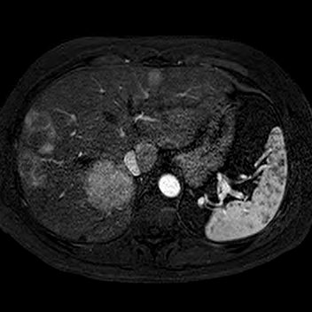
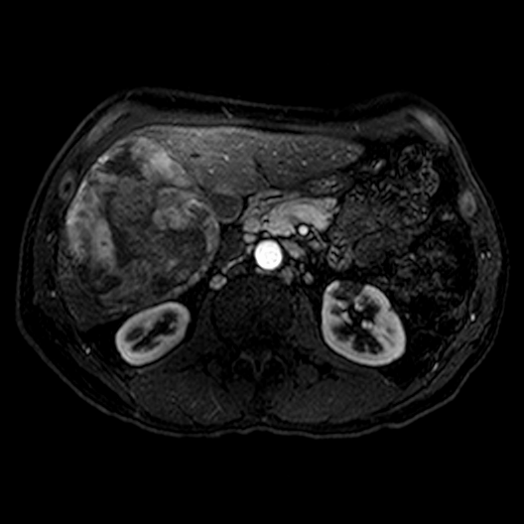
Review & Update Neuroendocrine Tumor Management
Luciano M. Vargas Jr. MD
Jean Grem MD
Lucienne Case RN
Haley Armstrong

Slide 2
Financial Disclosures
None

Slide 3
Definitions
Cancer: Uncontrolled Growth of Abnormal Cells in the body
Disease: Disorder in the Structure or Function of the Human body that produces Specific Signs or symptoms

Slide 4
Neuroendocrine Tumor
Classification
Functional vs Non
Location
Staging
Diagnostic Studies
Markers
Imaging
Interventional Management
Surgical management
Chemotherapies
Trials
Notes:
Epidemiology: 1 in 100,000 in 1970’s, 5.25 in 100,000 in 2004, increased incidence is due to better classification, improved detection & increased awareness

Slide 5
Functional vs Non-Functional
Functional
Pancreatic
Glucagonoma
Insulinoma
Somatostinoma
Small Intestine
Carcinoid Tumor
Non-Fuctional
Pancreas
Small Intestine

Slide 6
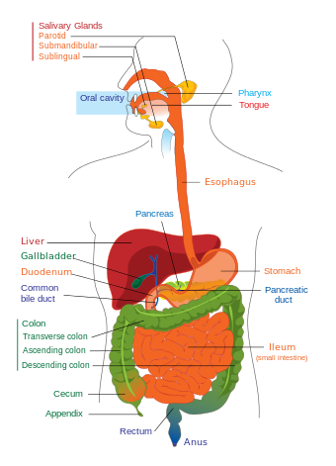
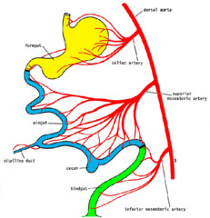
Location
Gut
Fore, Mid & Hind
Pancreas
Small bowel
TI most located in first 60 cm
25 % multifocal

Slide 7
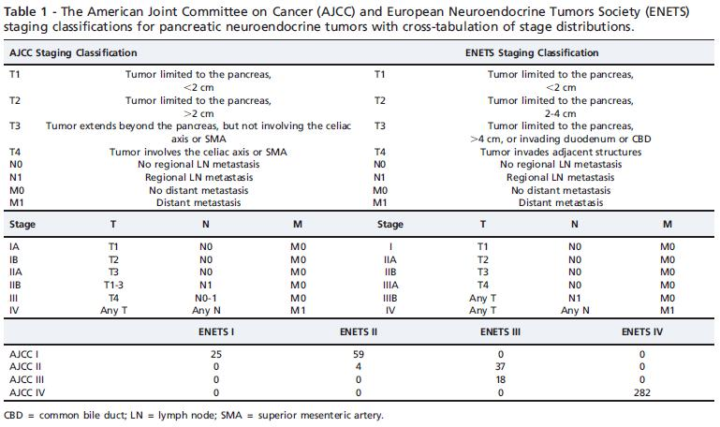
Staging Neuroendocrine Tumor
ENETS/AJCC TNM staging classification of small bowel NETs.
T1 Tumor invades lamina propria or submucosa and size one cm or less
T2 Tumor invades muscularis propria or size >one cm
T3 Tumor invades through the muscularis propria into the subserosa or into the nonperitonealized tissue
T4 Tumor invades the visceral peritoneum (serosa) or any other organs or structures
^{N0 No regional LN metastasis}
^{N1 Regional LN metastasis}
^{M0 No distant metastasis}
^{M1 Distant metastasis}
^{Stage}
^{I IIA IIB IIIA IIIB IV}
^{T}
^{T1}
^{T2}
^{T3}
^{T4 Any T Any T}
^{N M}
N0 M0 N0 M0 N0 M0 N0 M0 N1 M0 Any N M1

Slide 8
Diagnostic Studies
CT
MRI
Abdomen
MR Enterograpy
Octreotide Scan
Gallium Scan
Colonoscopy
Upper Endoscopy
EUS
Markers
5HIAA
Chromagranin A
Etc

Slide 9
Interventional Management
Ablation
Ethanol
Cryotherapy
RFA
Trans – Arterial Embolization (Bland Emobilization)
Trans – Arterial Chemoembolization
Selective Intrahepatic Radiotherapy (SIRT)
Theraspheres
Indication
Notes:
Ablation: oligomets ususally, RFA, Enthanol, Cryo

Slide 10
Surgical Management
Resection of the primary
Lymphadenectomy
Liver Metastasis
Single staged Resection
Staged Resection
Two Staged
ALPPS procedure (Associating Liver Partition with Portal vein ligation for staged Hepatectomy)
Transplantation
Liver
Liver / Small bowel
Notes:
Resection of Primary: Small primaries can lead to big problems

Slide 11
Chemotherapy
Somatostatin Analogs
Octreotide & Lanreotide
2 & 5, +/- 3
Pasireotide
1,2,3,&5
Angiogenesis Inhibitors
Bevacizumab
Sunitinib
Interferon- α
Cytotoxic Drugs
Temozolamide
Streptozocin
PRRT (Peptide Receptor Radiolabled Therapy)
Notes:
Temozomaide : alkalyating agent of dna that leads to cell death
Streptozocin:

Slide 12
Trials
1 Not yet recruiting Randomized Phase III of PRRT Versus Interferon
Condition:Gastro-intestinal Neuroendocrine TumorsInterventions:Drug: Interferon alpha-2b; Drug: 177Lu-octreotate
2 Recruiting 177Lutetium-octreotate Treatment Prediction Using Multimodality Imaging in Refractory NETs
Condition:Gastroenteropancreatic Neuroendocrine TumorsIntervention:Drug: intravenous injection of 177Lu-octreotate

Slide 13
Conclusions
Cancer: Uncontrolled Growth of Abnormal Cells in the body
Disease: Disorder in the Structure or Function of the Human body that produces Specific Signs or symptoms
Neuroendocrine Cancer is difficult to eradicate
Current management allows for Neuroendocrine Cancer to essentially become an Indolent and Chronic disease

Slide 14
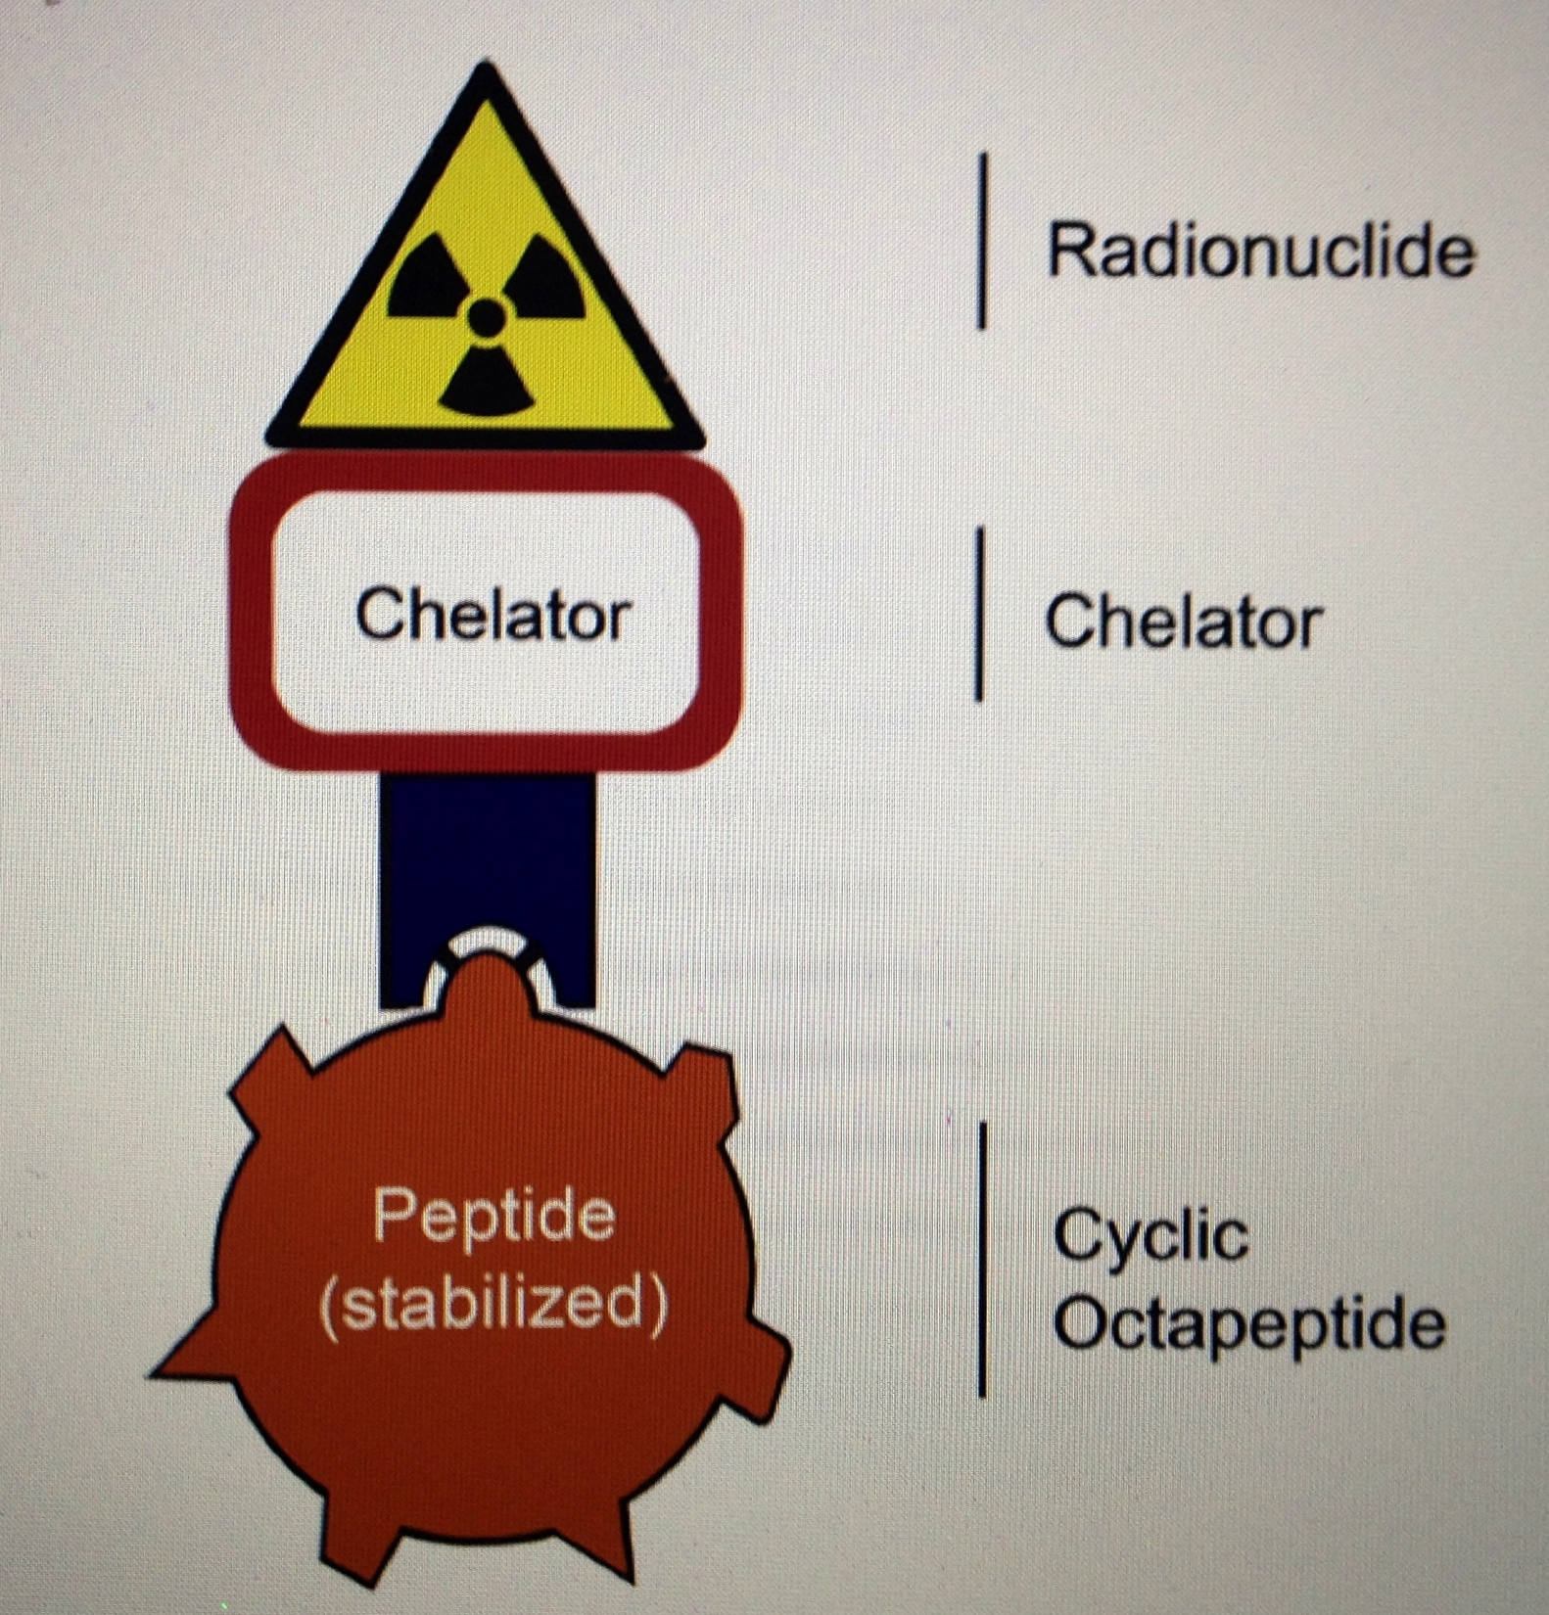
PRRT
PRRT (Peptide Receptor Radiolabled Therapy)
Indium -11
Yttrium - 90
Lutetium - 177
Notes:
In & Y have have lives of 2.8-2.5 days
Lu ½ life ~6 days 2mm penetration ( good for smaller tumors)
Y12mm penetration (good for large tumors)

Slide 15
