Slide 1
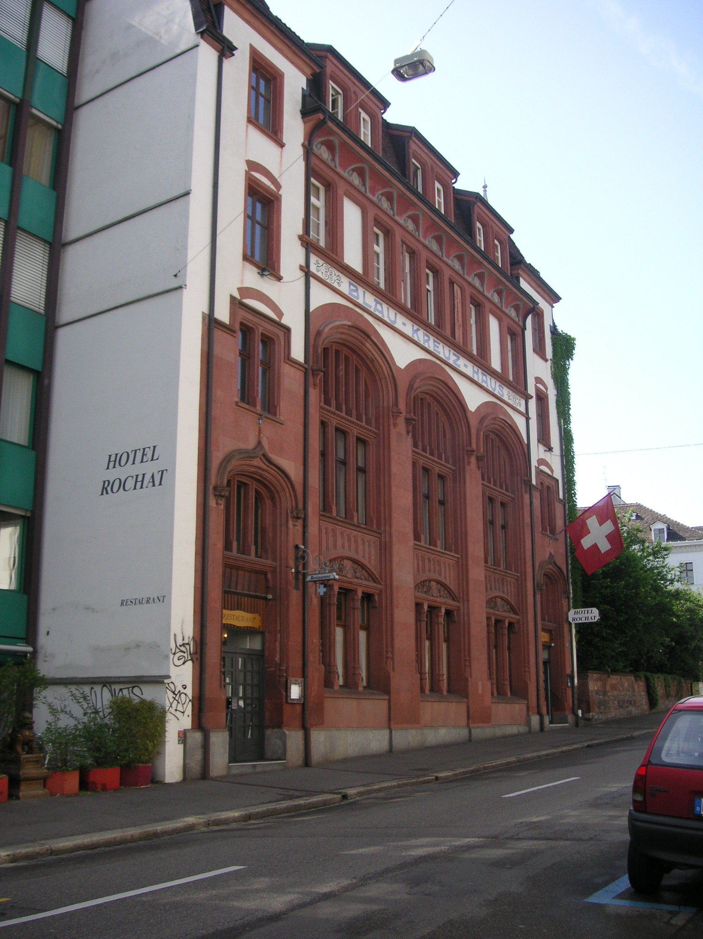
Hotel Rochat
As you face the hotel, the
hospital entrance is only a
few hundred paces down hill
to the left.
Go down hill to the left
and you will find a fruit market,
a tram stop, and the Rhine River.
Go up hill to the right for 30 paces,
and turn left to go down the stairs
to the Marketplatz.

Slide 2
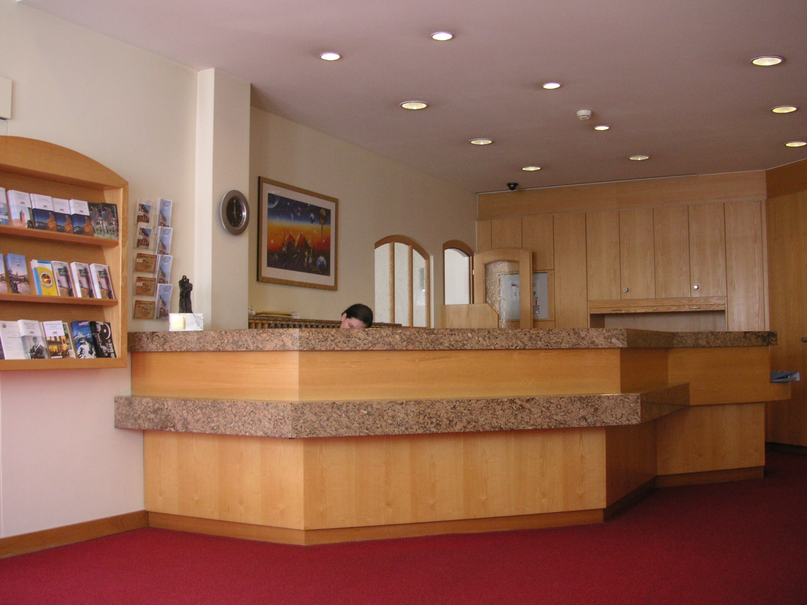
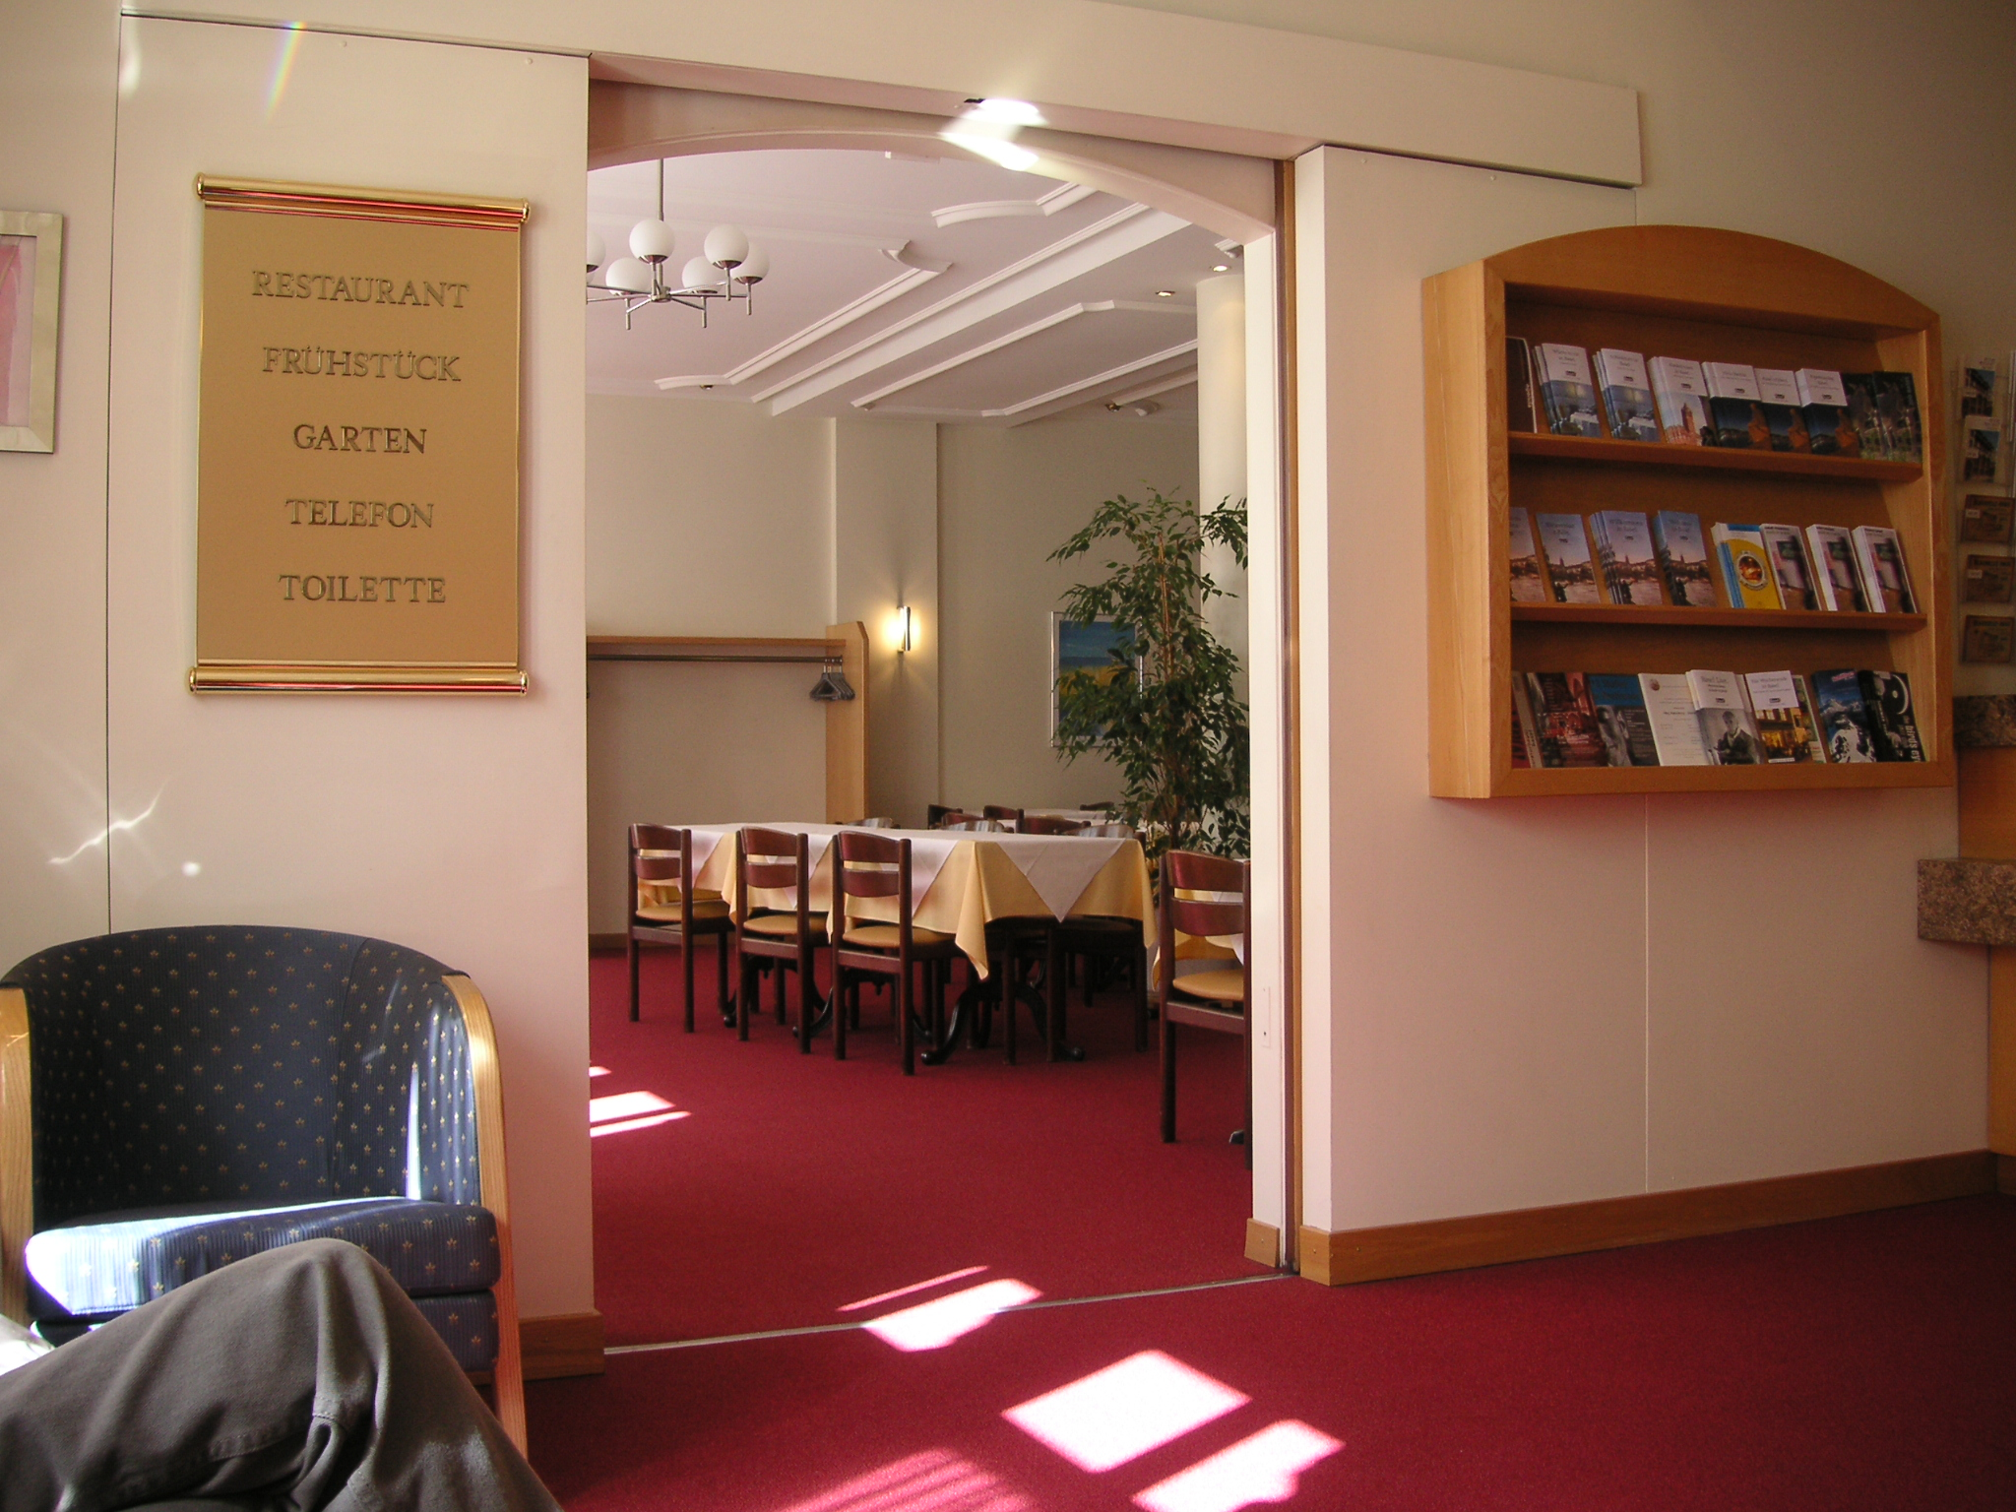
Hotel Rochat Lobby and Dining Room
That’s Verena behind the desk. Also you will meet Celine there.
All these people speak several languages.
Entrance to dining room, serving breakfast and lunch. (Breakfast
included with room rate.)
The business center is through this door and behind the wall you see
with the light on.

Slide 3
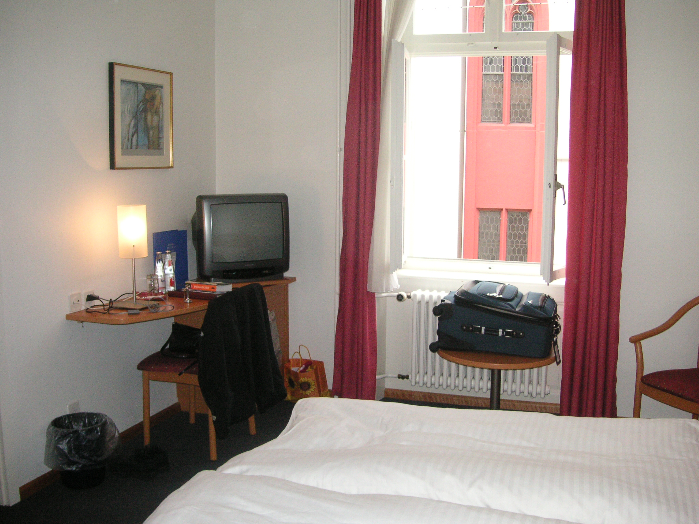
Hotel Rochat Room
Peters kirke is seen out
the window.
The TV has only one or
two English speaking
channels.

Slide 4
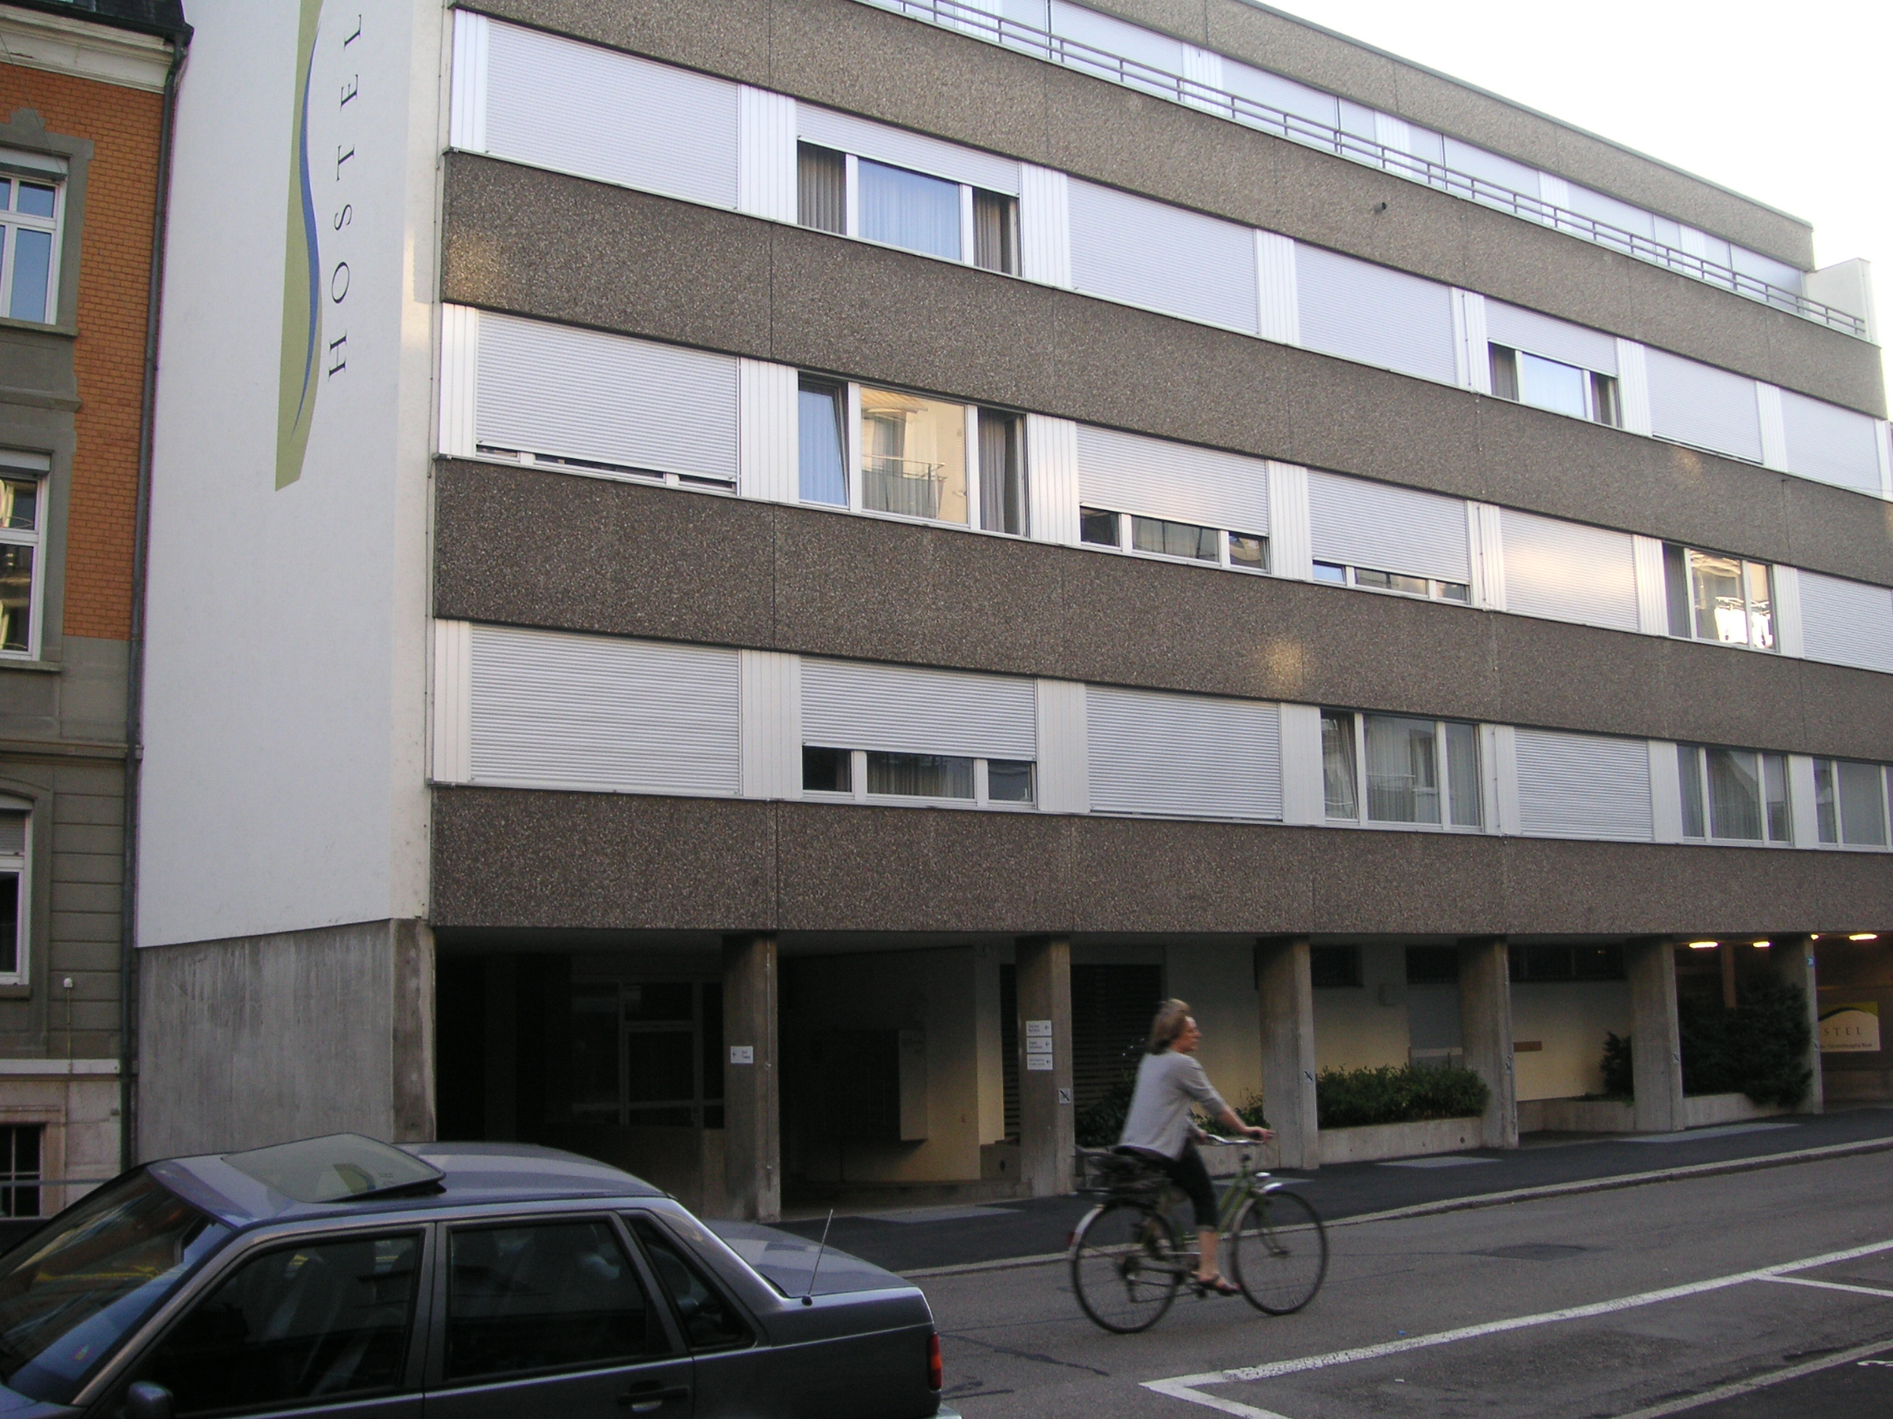
University Hospital Hostel

Slide 5
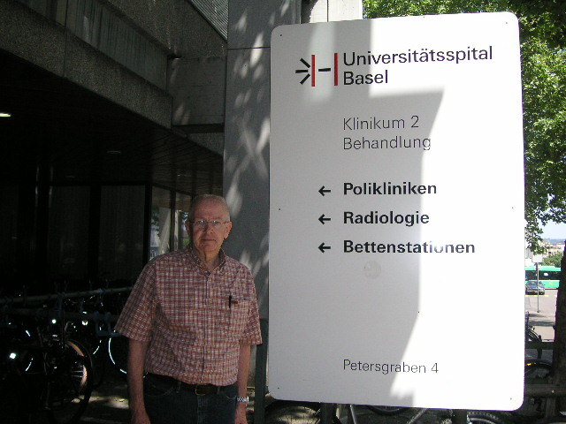
University Hospital Entrance

Slide 6
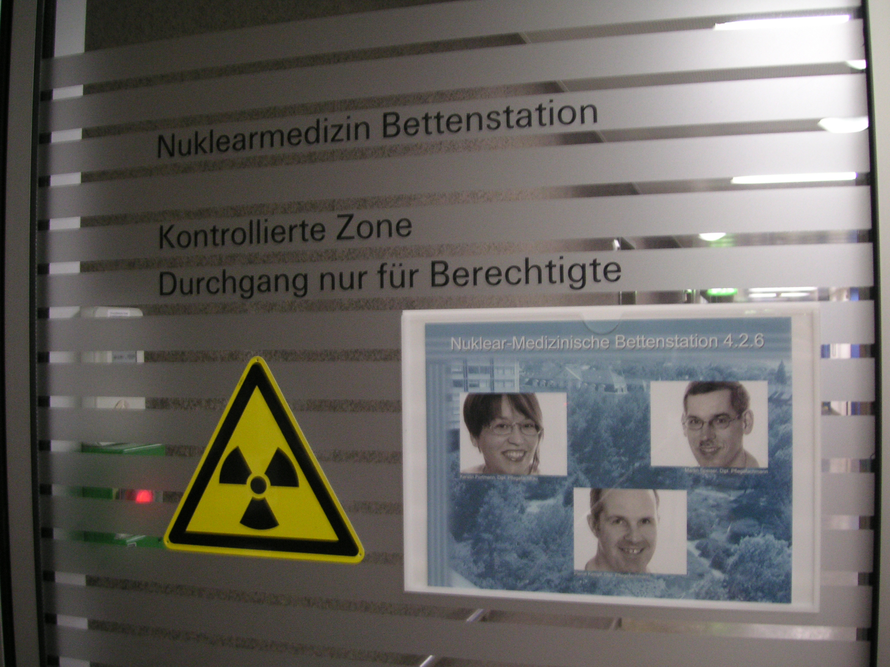
Entrance to The Hospital Rooms
Nurses Kerstin Portman,
Pierre Kempf (bottom),
and head nurse Martin Speiser
(top right)
who will be taking care of you.
They are Der Pflegeverantwortliche
All speak English
Take elevator to 4th floor.
Ring buzzer to request access.

Slide 7
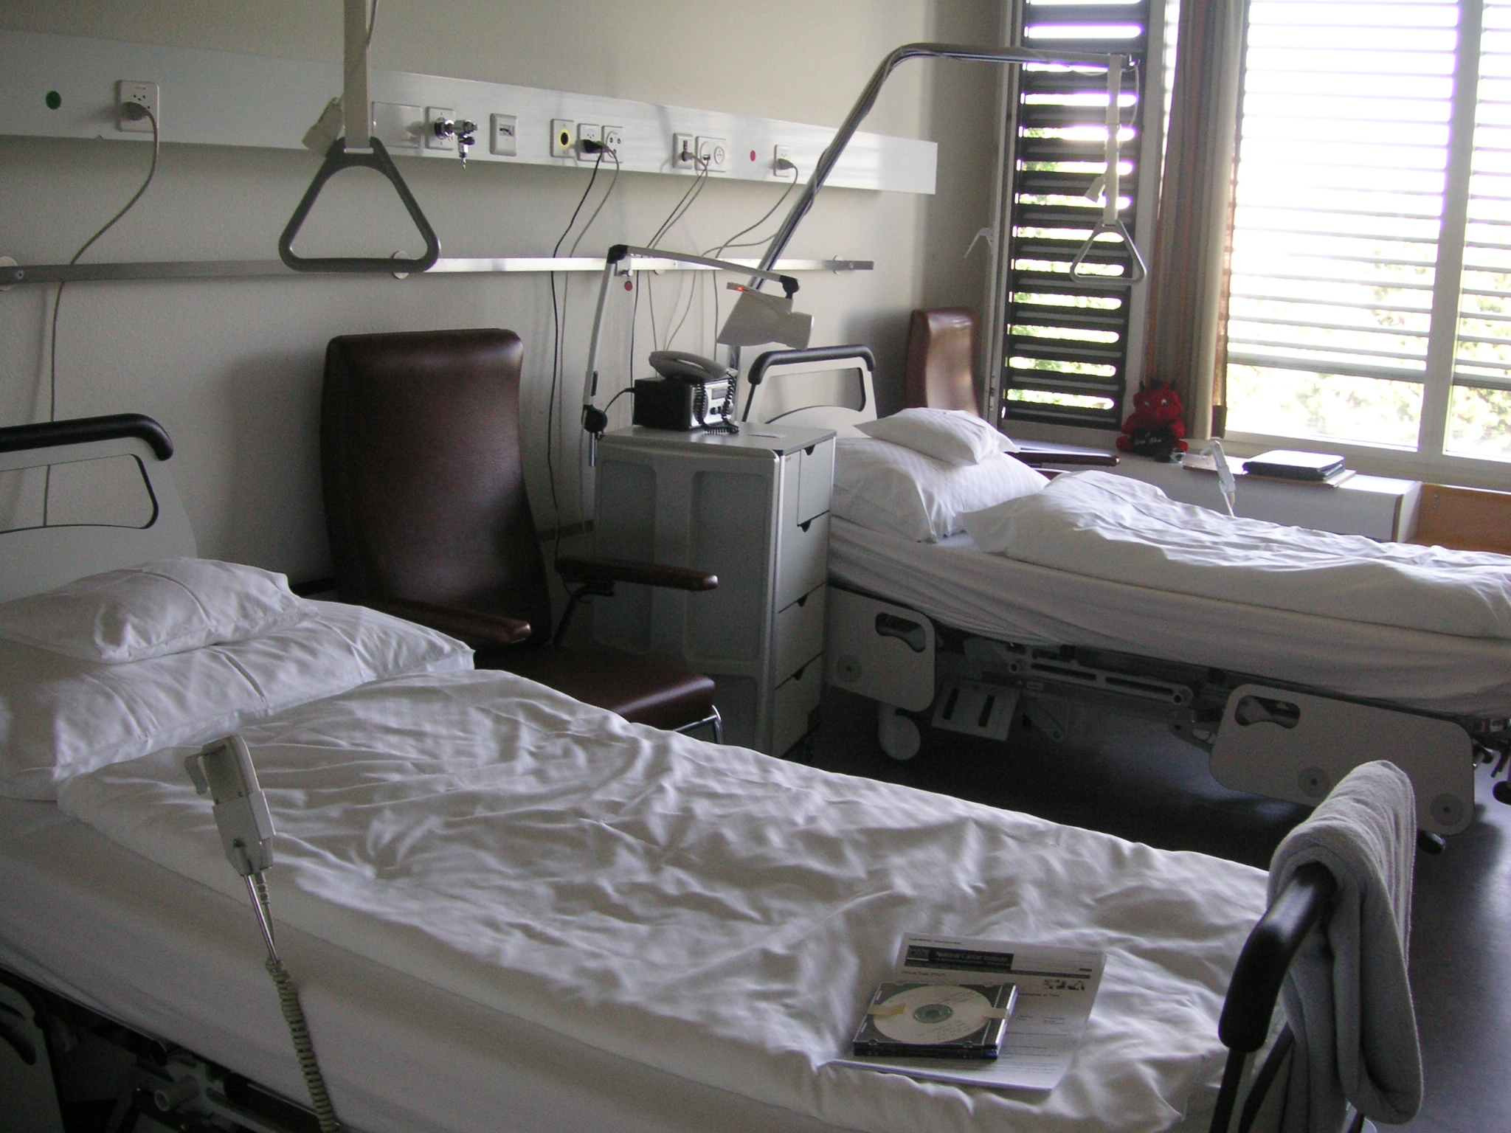
Hospital Room
This happens to be
the room with 2 beds.
There are 6 treatment
rooms with 7 beds.
The horizontal vents next
to the window are used for
fresh air ventilation.

Slide 8
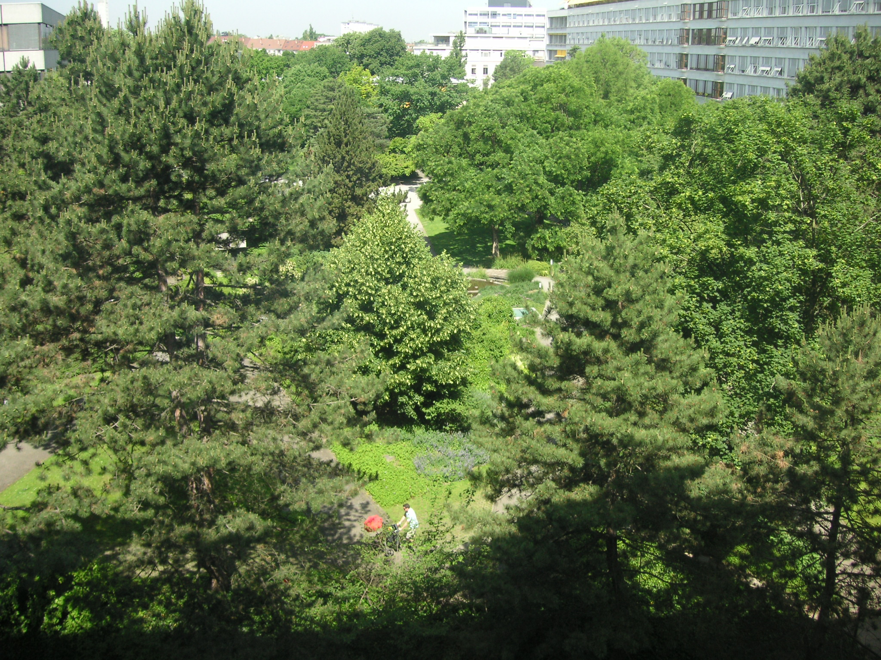
Hospital Room Court Yard View

Slide 9
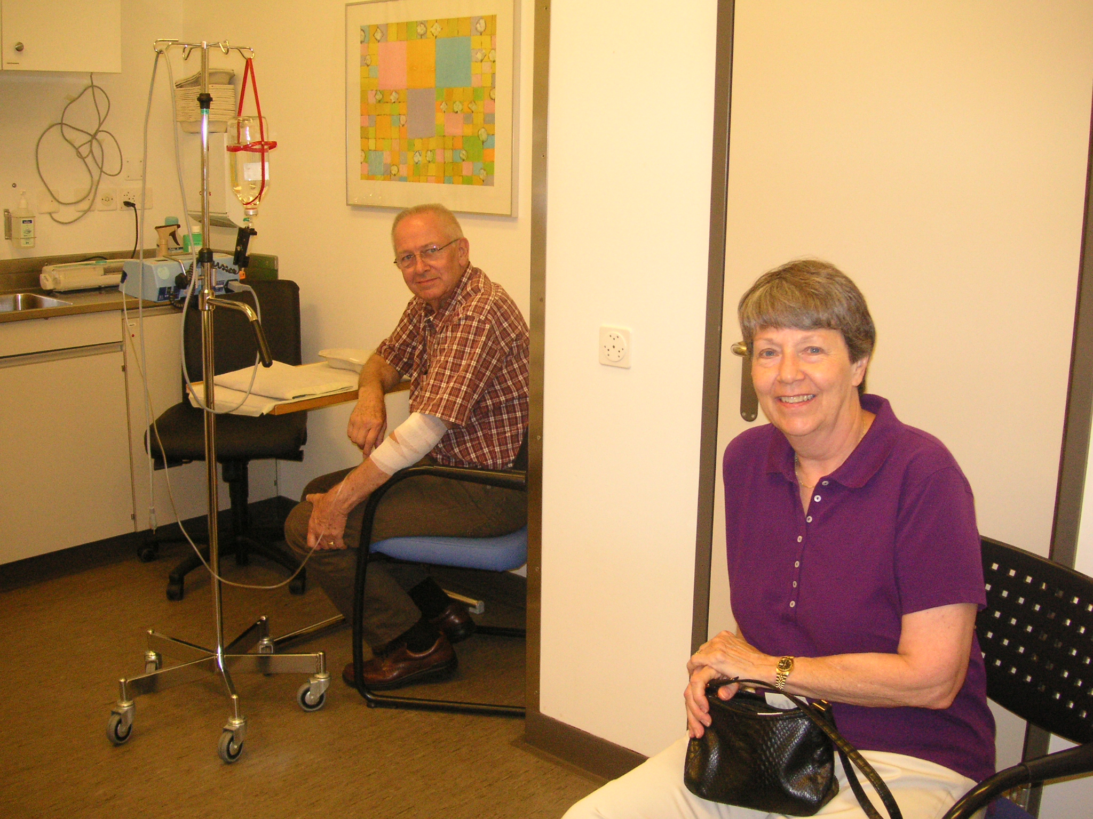
Infusion Room
The amino acids 1000 ml
bottle is hanging from
the IV pole.
Waiting for the injection.

Slide 10
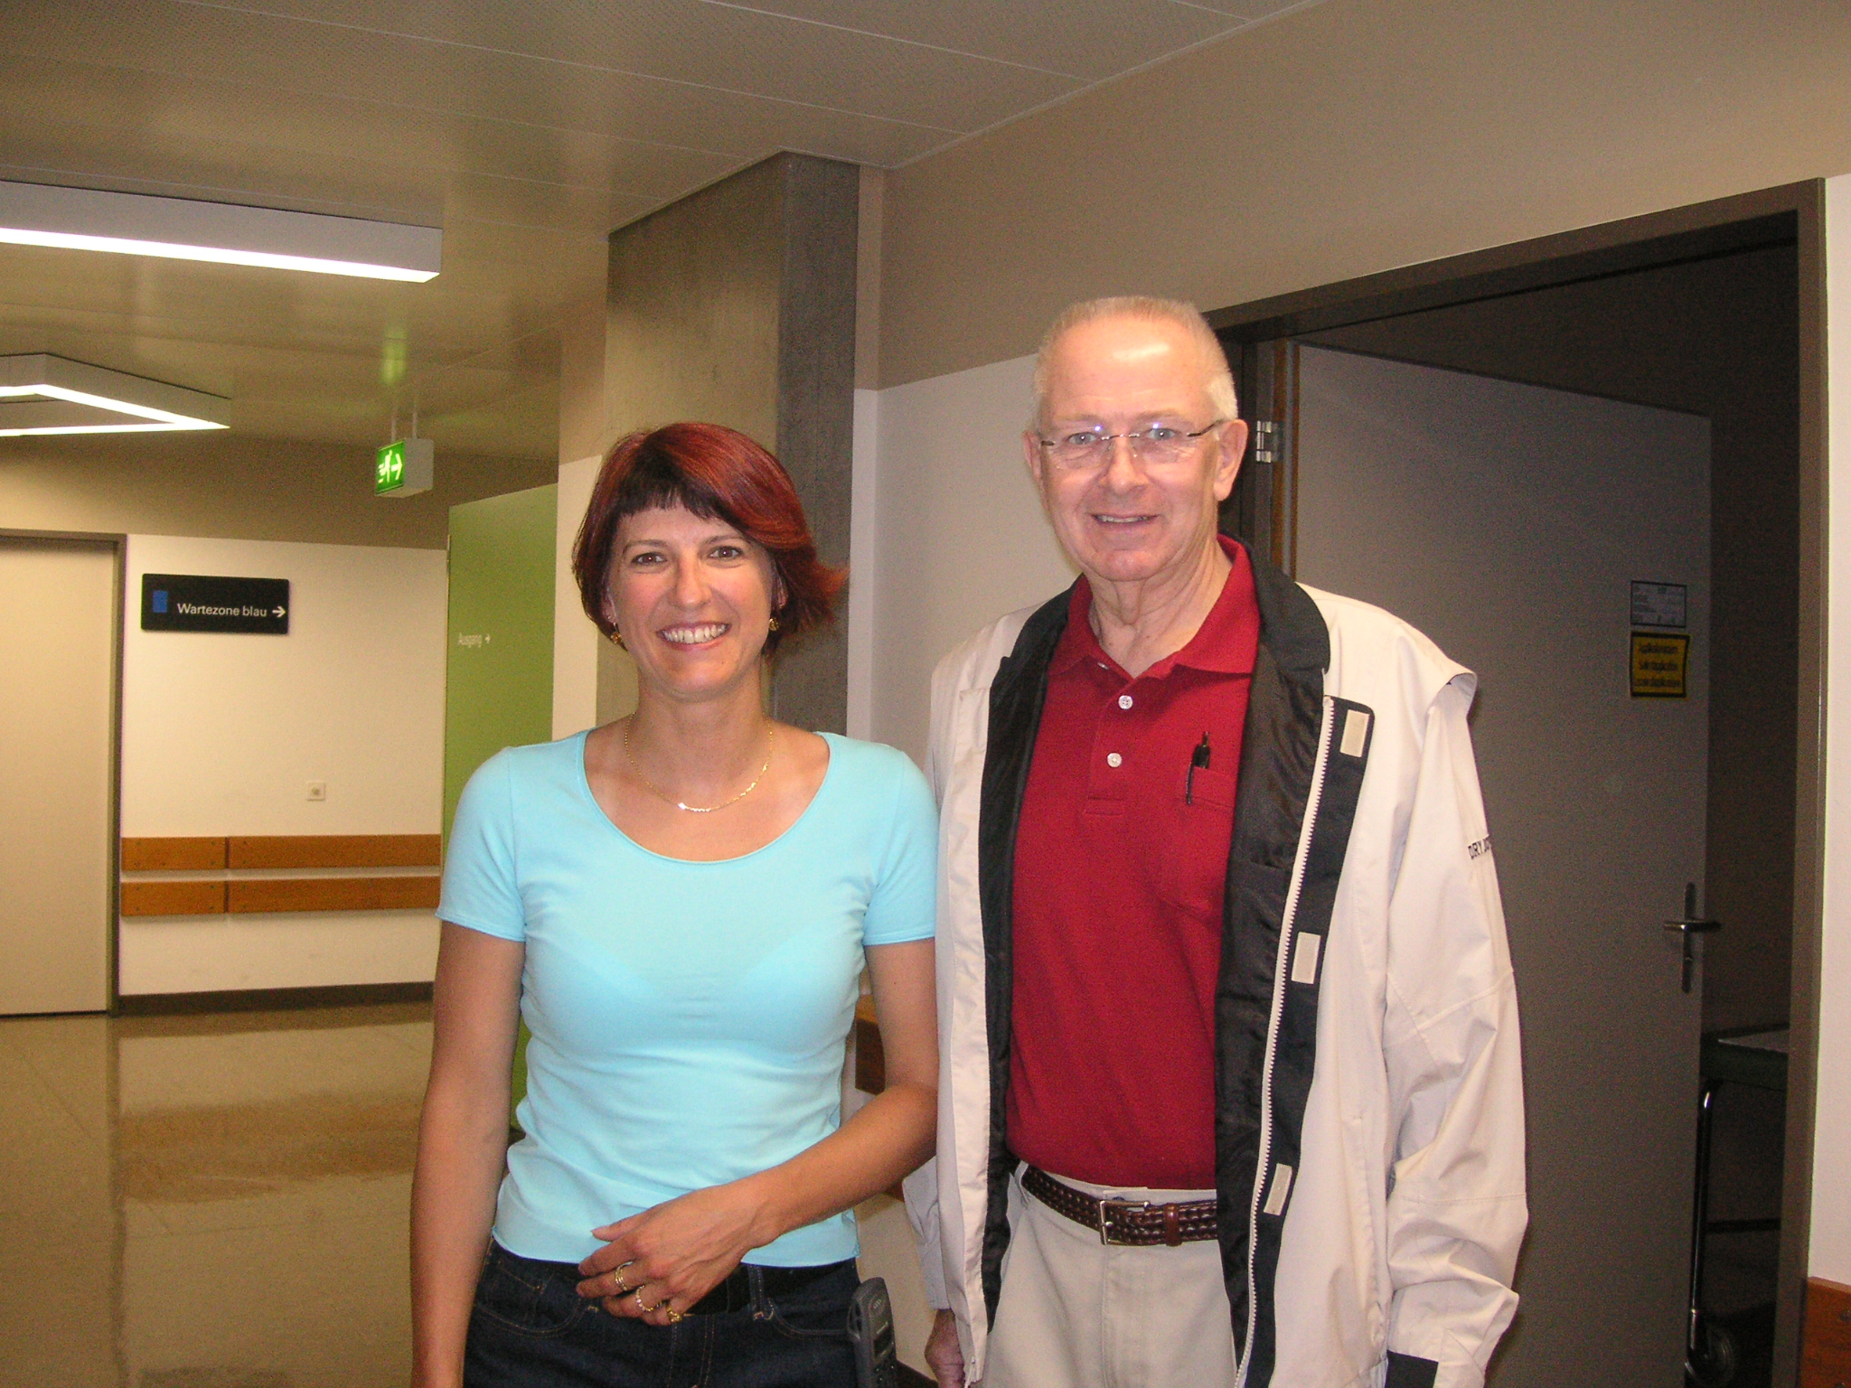
The Infamous Brigit Avis
She is the one on the left.

Slide 11
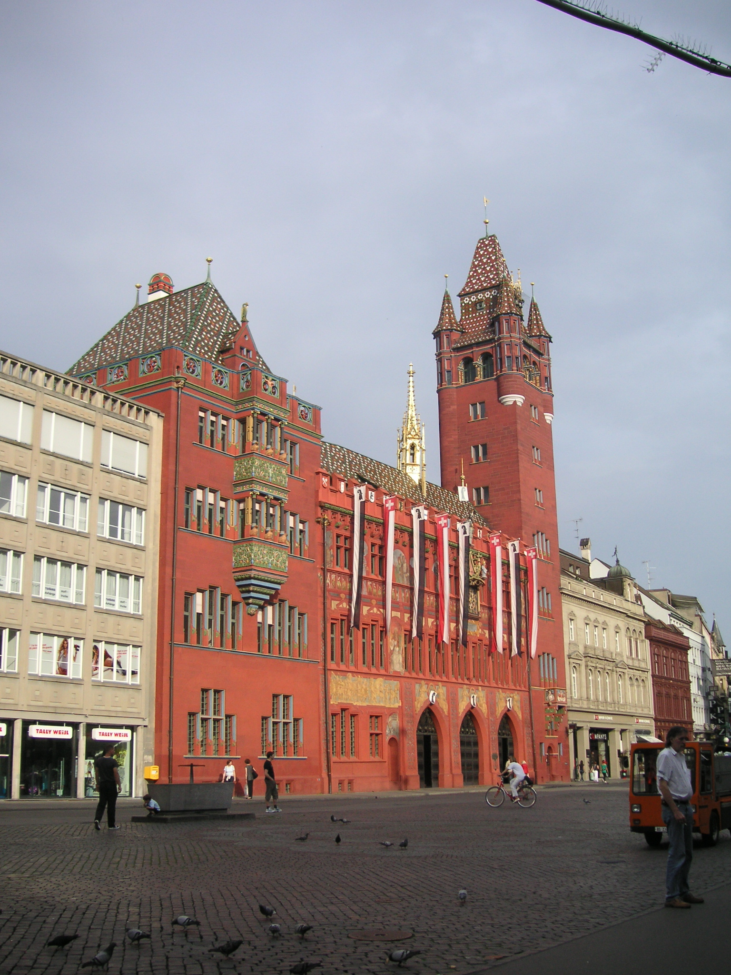
Rathaus in Marketplatz
The open area is part of the Marketplatz,
open 6 days/week.
This picture was taken on a Sunday when it
was closed. All restaurants were open
on Sunday.
To the right or left of the Rathaus a few
hundred feet,
you will find the MobileZone stores.

Slide 12
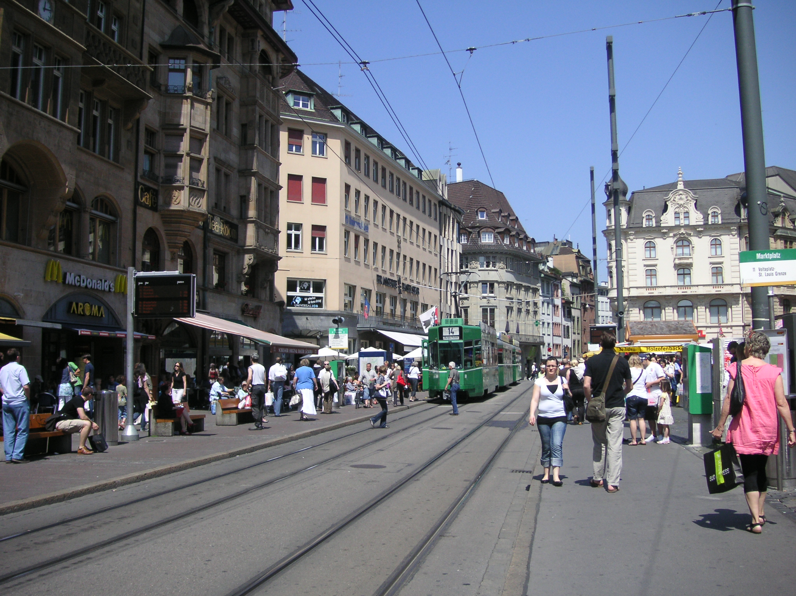
The Marketplatz When it’s Open
All the tram lines run
through the Marketplatz.
Picture taken in late May.
Many places to eat and shop.
Tram maps are in the hotel.
Hard to get lost.
Walking along this street leads
to the close by Rhine River.

Slide 13
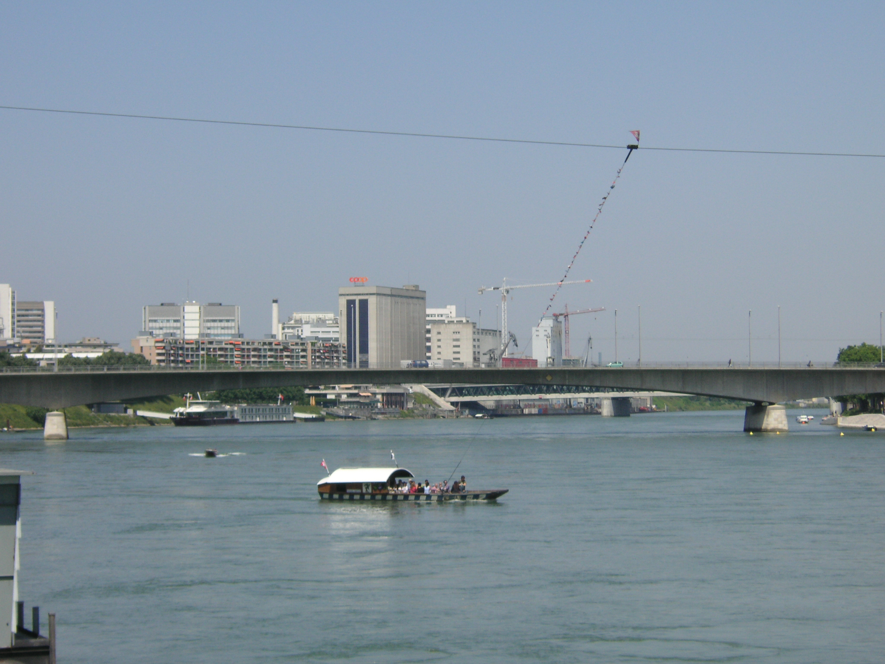
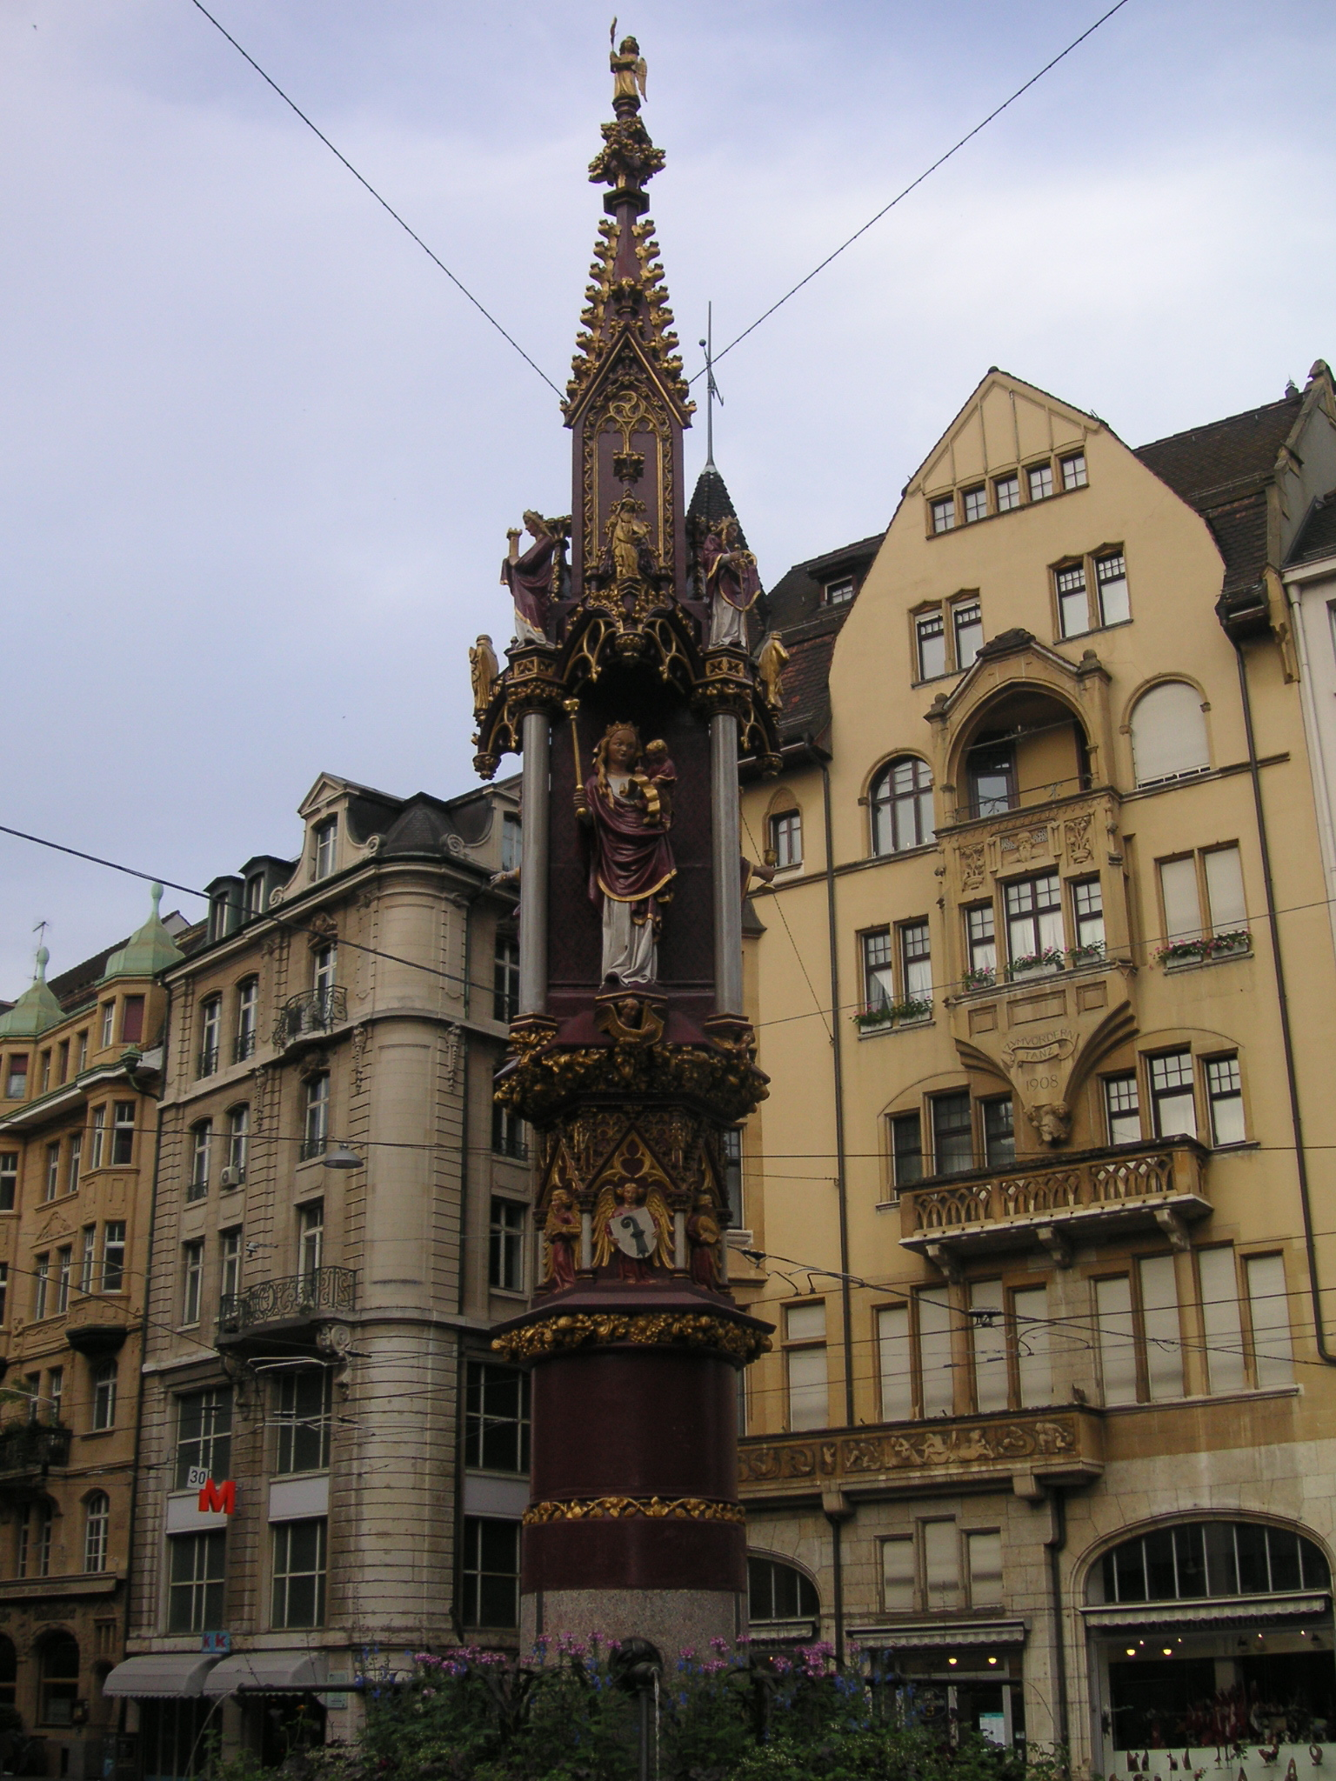
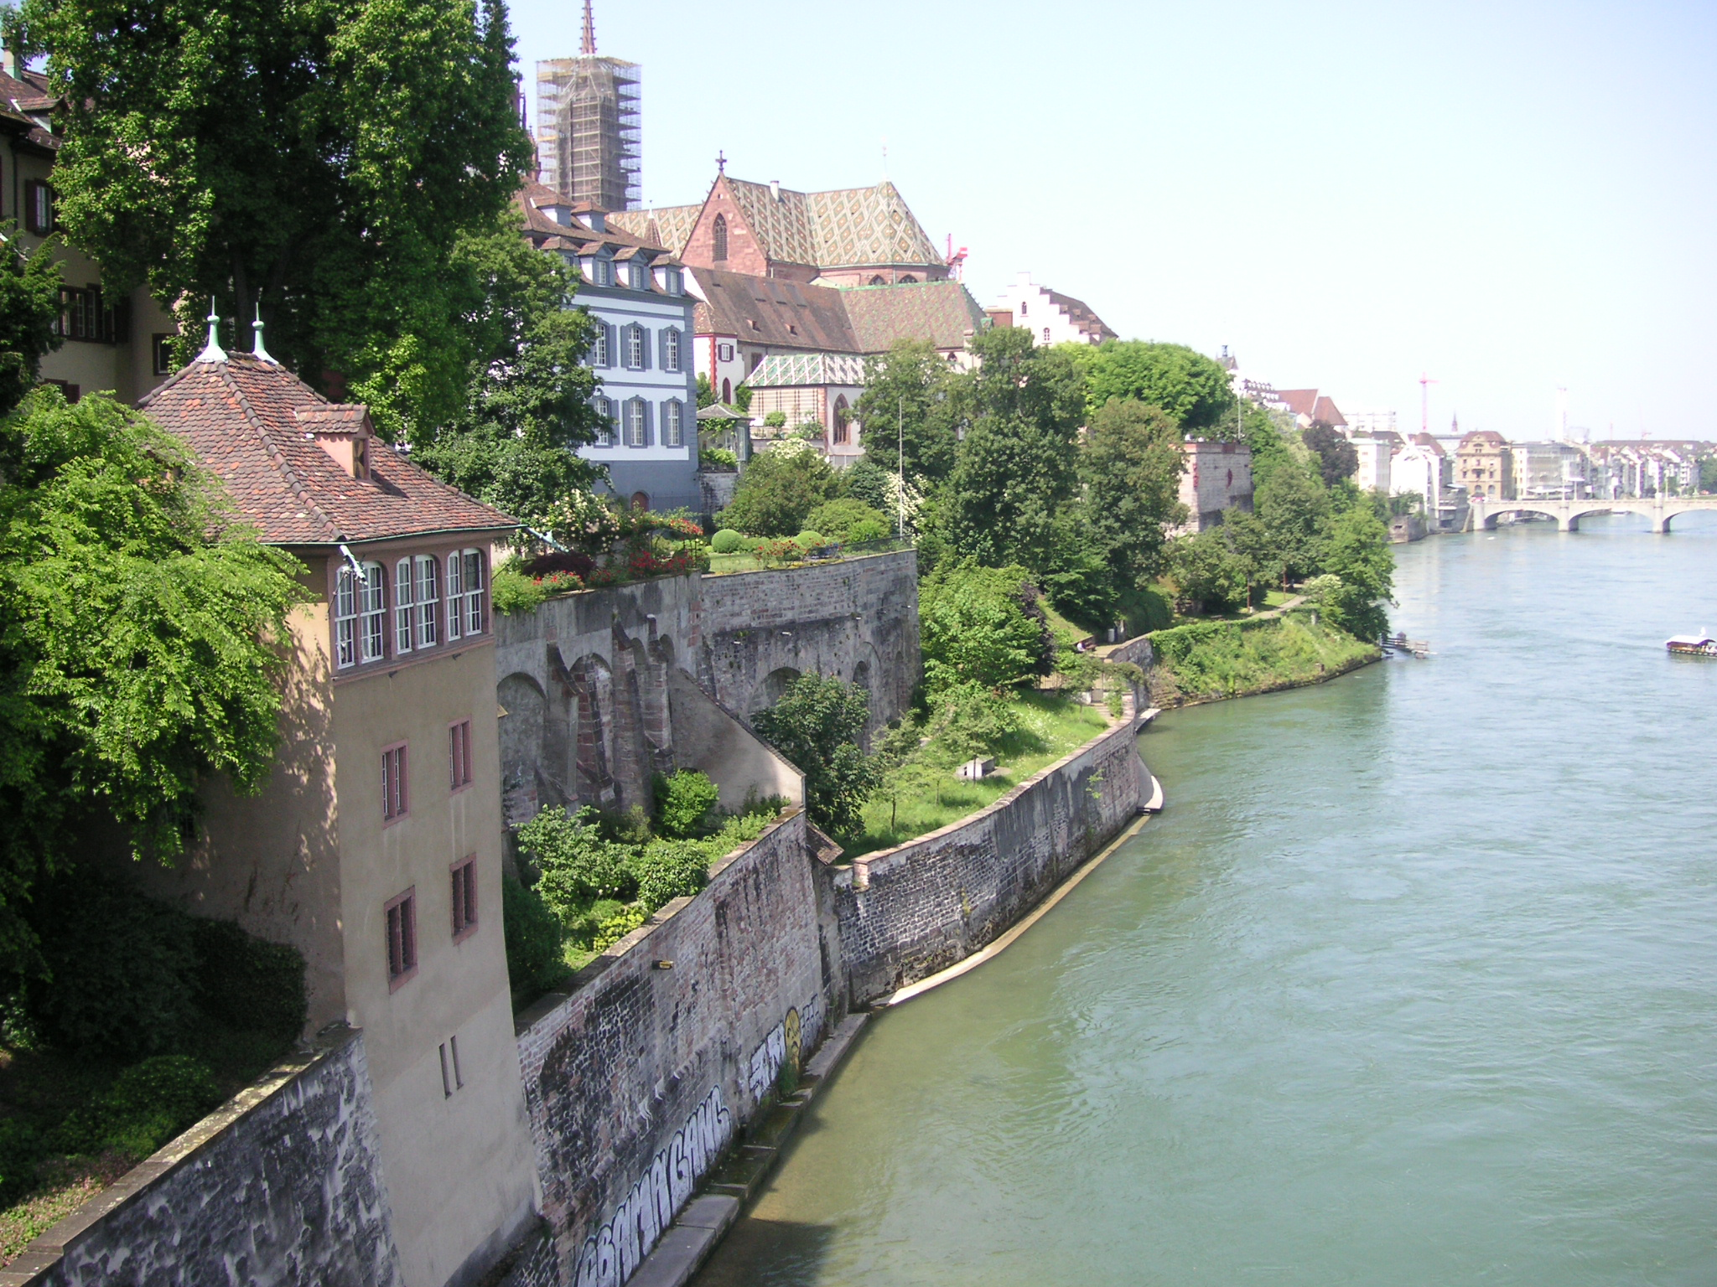
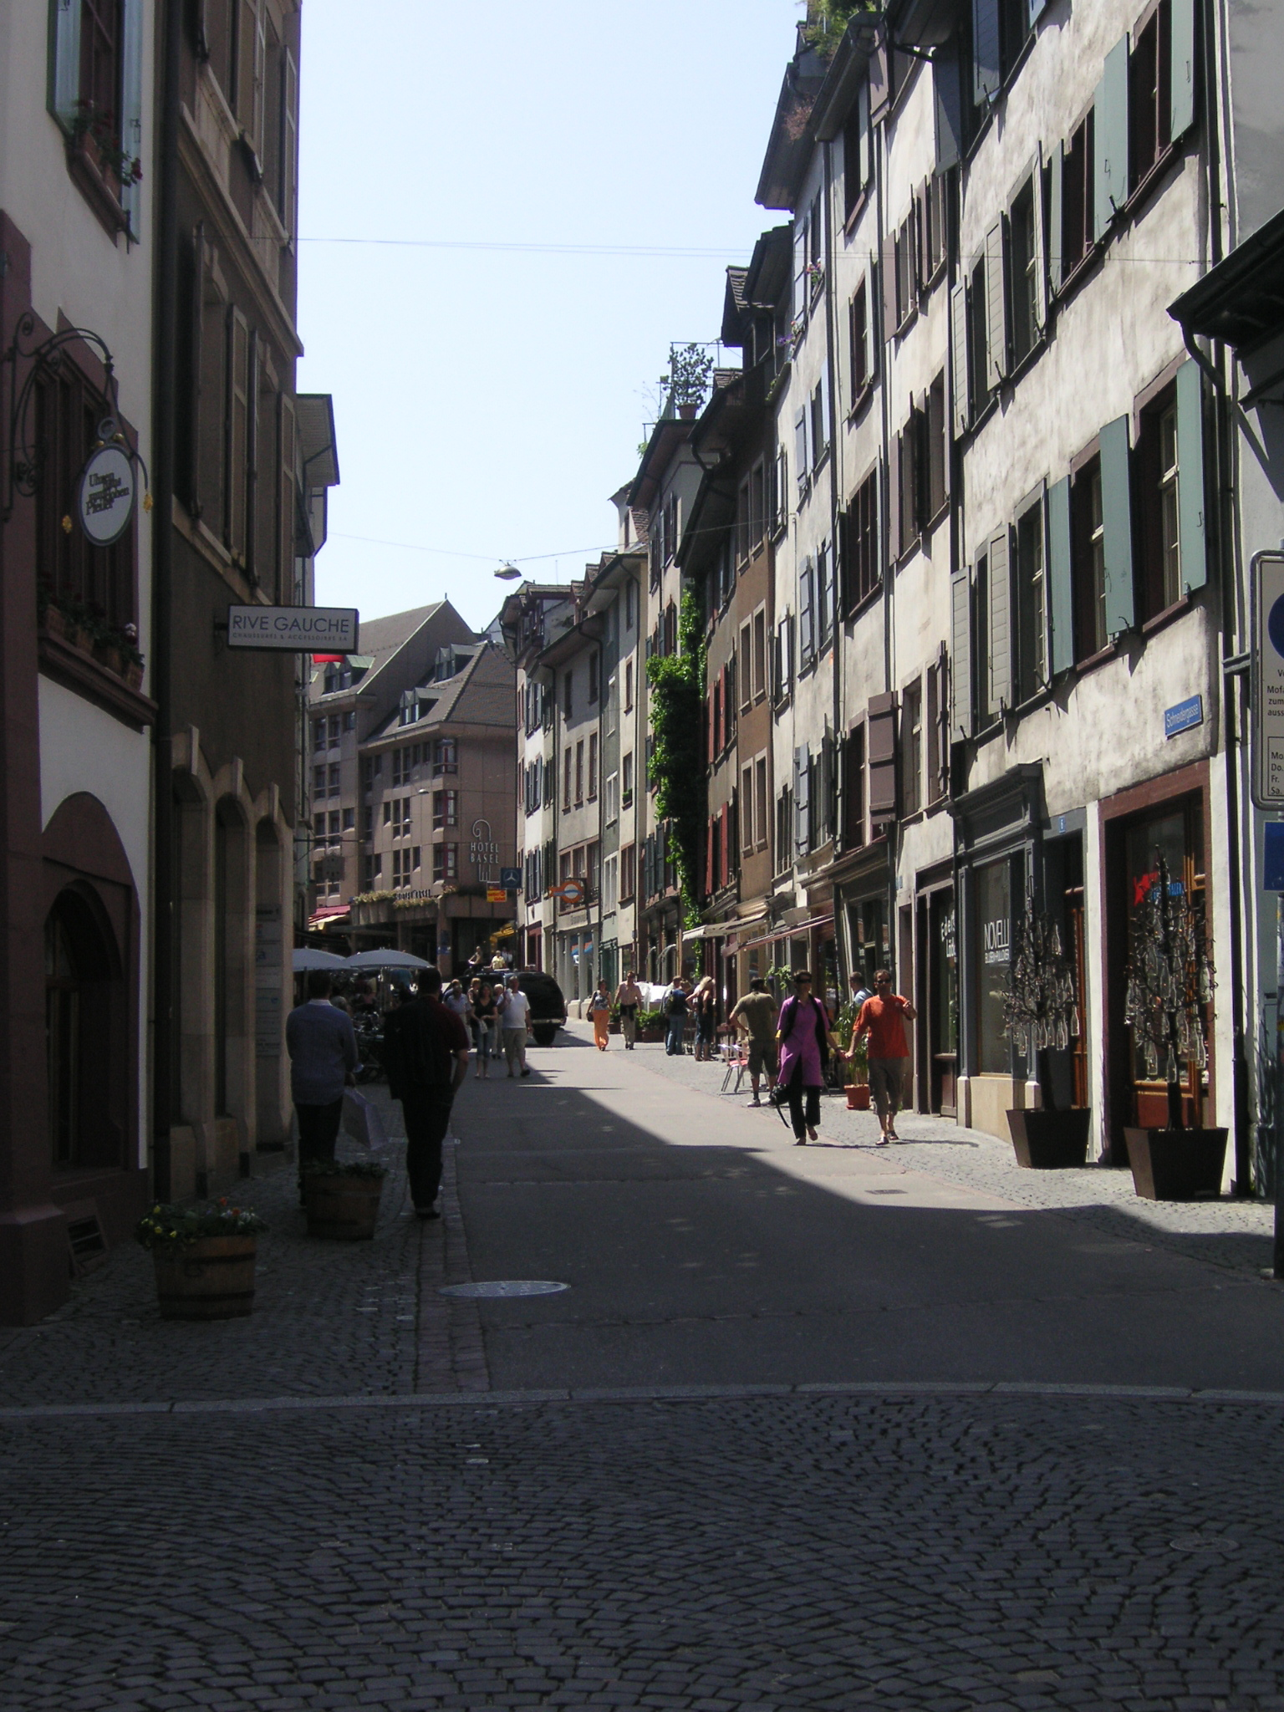
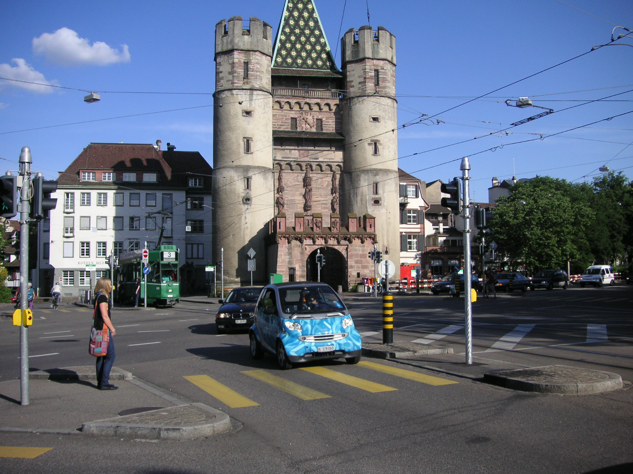
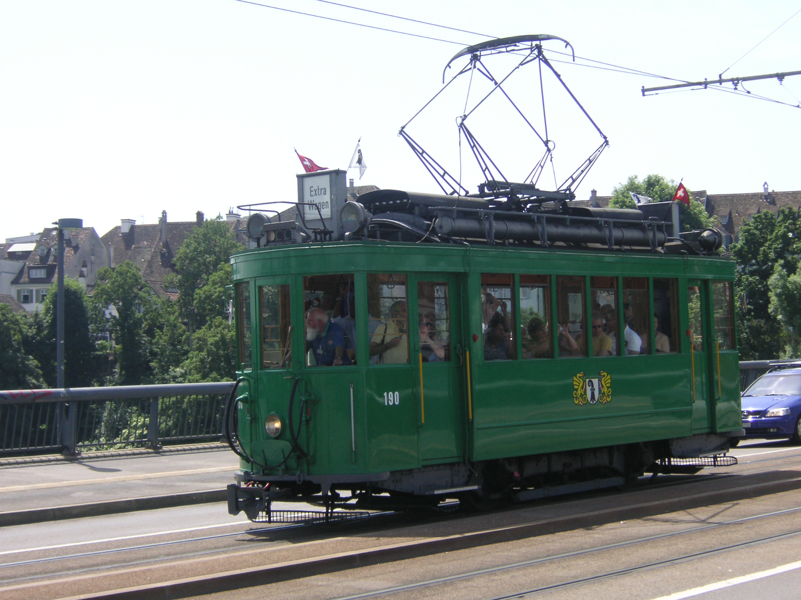
Go Explore

Slide 14
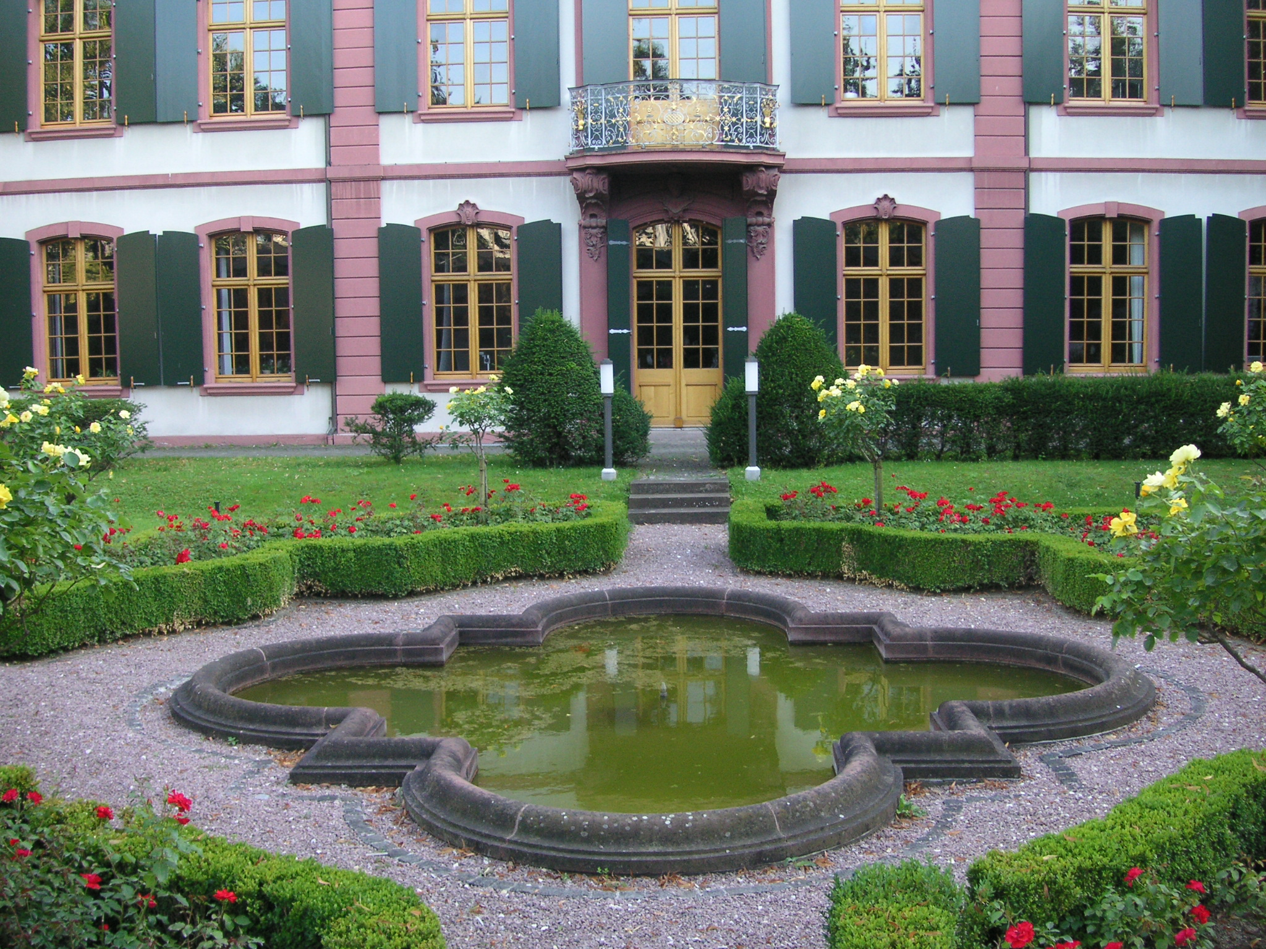
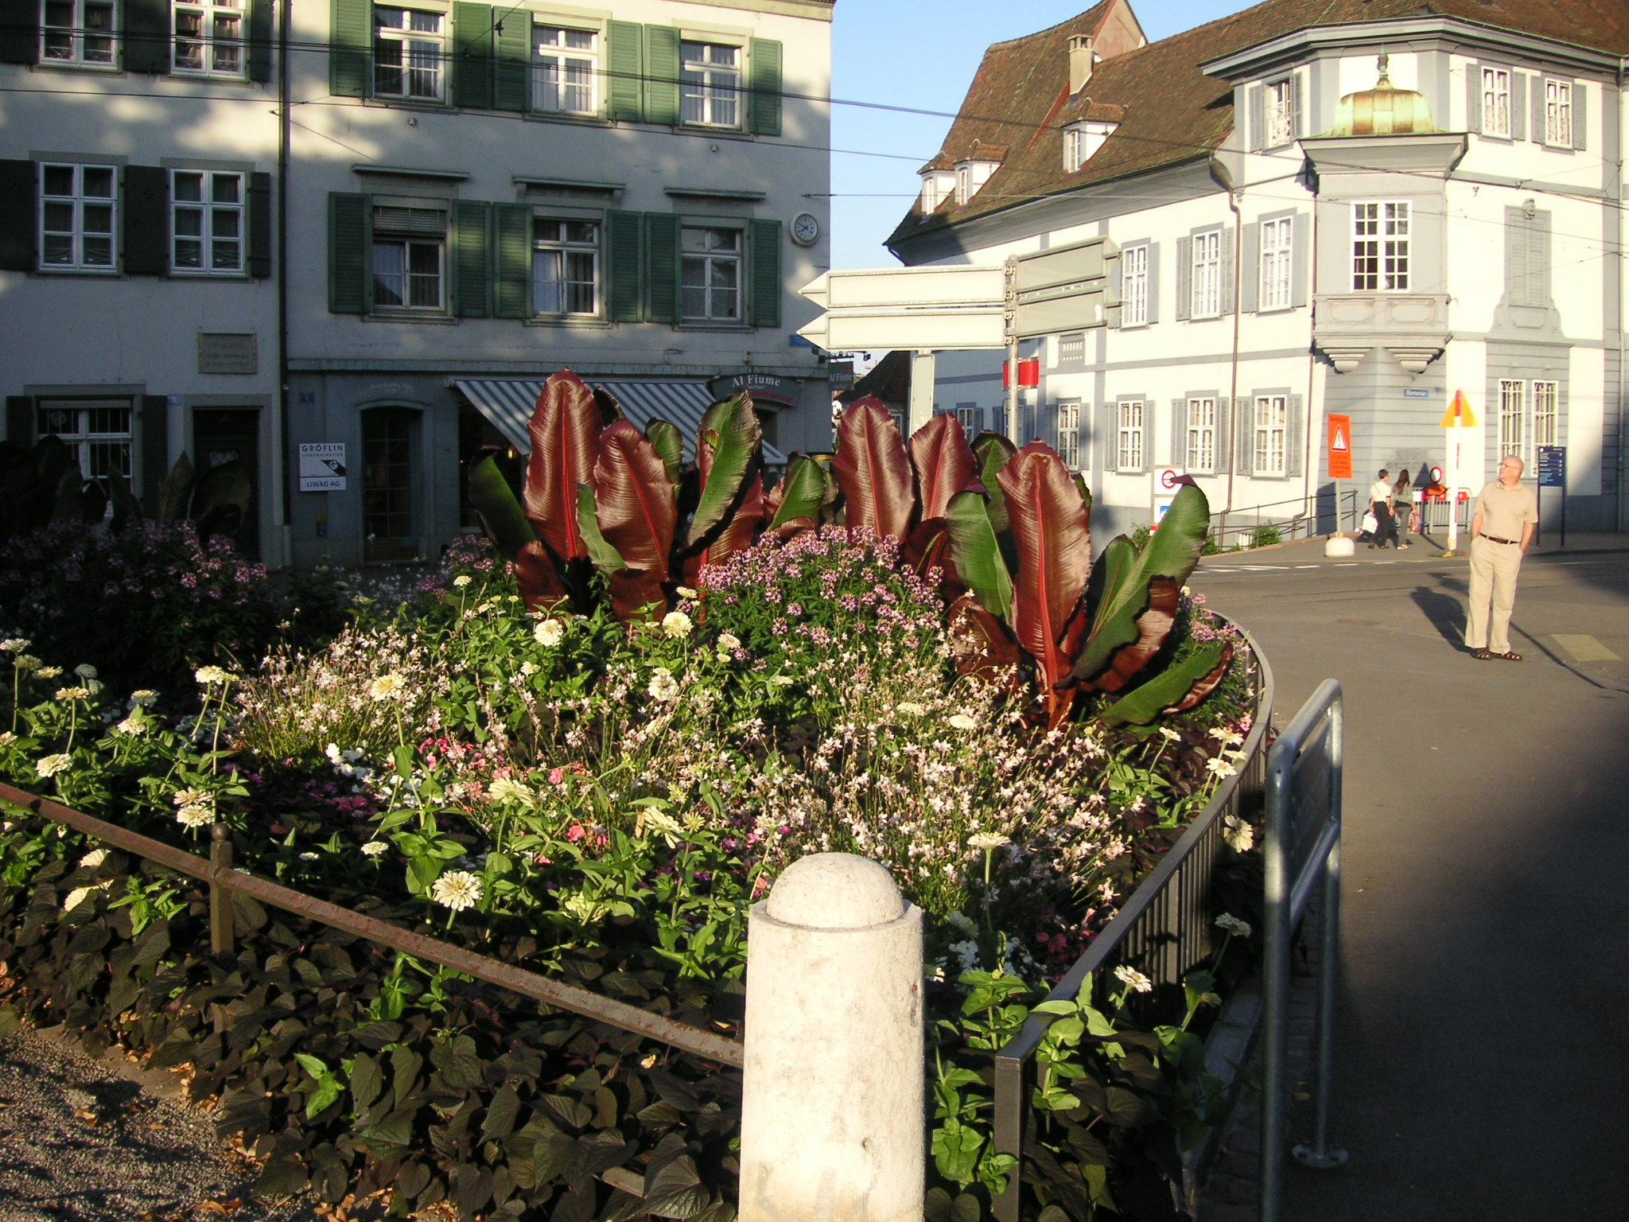
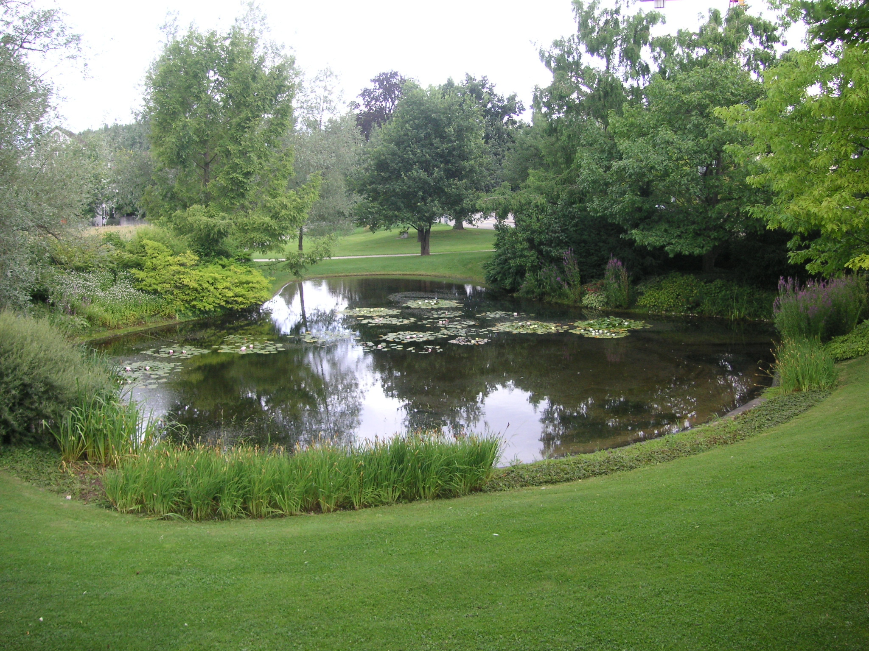
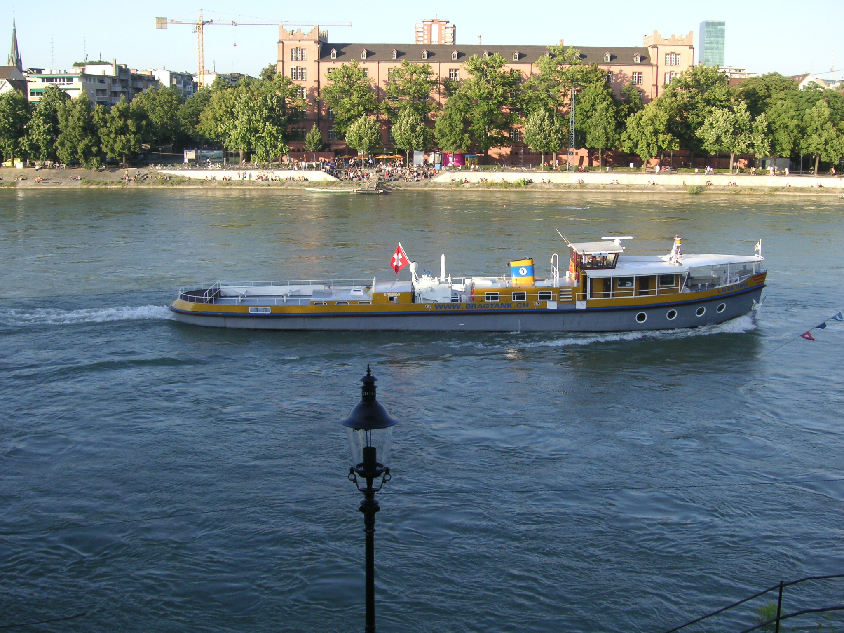
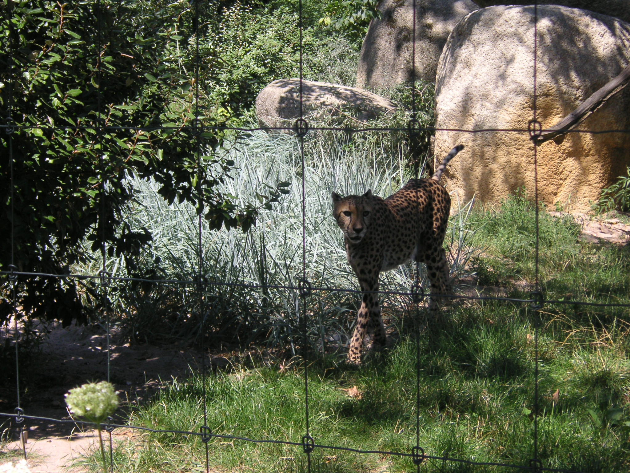
More Go Explore

